Slide 1
Data and Algorithm 14
Chulalongkorn University
School of Integrated Innovation
Fall 2023
Marko Niinimaki Marko.N@chula.ac.th

Slide 2
Where are we?
14 | 14 Nov | Working with Data
15 | 21 Nov | Summary (no class)
Please check the Exam Instructions document in Class Materials.

Slide 3
Main topics for the final exam
Bits, bytes and files
Sort/find algorithms and the Big O notation, merge sort O(n * log(n))
Databases and database management systems
Basic web technologies: HTML and HTTP.
Relational databases and the relational model
SQL
noSQL databases
Blockchains, hash functions and hash tables
Linked lists
JSON and APIs
Cloud computing and Cloud service models
Text databases
Cloud platforms like Python Anywhere
Stacks, queues and heaps
Big Data (today)

Slide 4
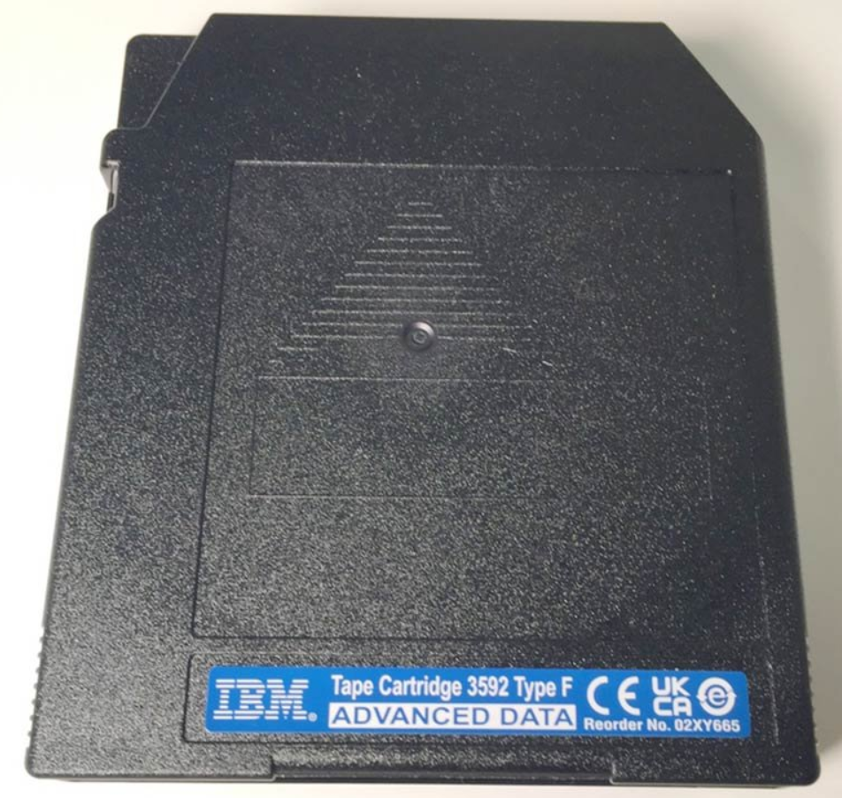
Bytes once again
1 byte, 8 bits, range 0..255, typically stores 1 character (except e.g. Thai script)
1 kilobyte, 1000 (or 1024) bytes, about 1 page of text in English
1 megabyte, 1000 (or 1024) kilobytes. A typical mobile phone camera image is 2 or 3 megabytes.
1 gigabyte, 1000 (or 1024) megabytes. A short film (today’s normal resolutions) or a TV series episode. A browser like Google Chrome ~ 1 GB.
1 terabyte, 1000 (or 1024) gigabytes. The capacity of a typical laptop disk.
1 petabyte, 1000 (or 1024) terabytes. CERN stores about 1 petabyte of physics data per year [on disks and tapes].
1 exabyte, 1000 (or 1024) petabytes.
1 zettabyte, 1000 (or 1024) exabytes. We create about
120 zettabytes each year. Much of that is by IoT.
https://explodingtopics.com/blog/data-generated-per-day
The tape cartridge in the picture ~ 150 terabytes.
Notes:
https://data.commoncrawl.org/crawl-data/CC-MAIN-2023-40/index.html ~100 TB compressed. May be about 1 PB uncompressed.

Slide 5
Who has the data?
Individuals? Documents, photos, music, videos and (oddly) games. Some gigabytes to terabytes.
The average company manages 162.9TB of data, the average enterprise has 347.56TB of data, seven times as much data as the average SMB with 47.81TB.
IDG Data Analytics Survey 2016.
Big tech companies: Petabytes.
Governments? A lot.
https://www.zdnet.com/article/us-government-has-12166-data-centers-and-most-of-them-inefficient-can-hybrid-save-the-day/ (2019)

Slide 6
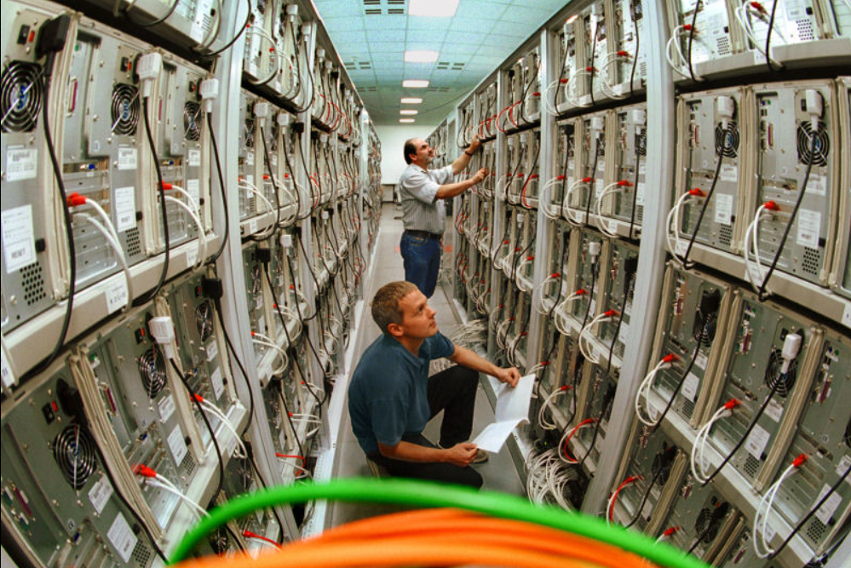
What is Big Data?
Often described by Volume (lots of data), variety (comes in different formats) and velocity (data is produced at high rates).
"Big data is where parallel computing tools are needed to handle data" (Fox, Charles: Data Science for Transport. Springer Textbooks in Earth Sciences, Geography and Environment. Springer).
So, it’s simple .. we need cluster or cloud resources that handle data in parallel?
A computer cluster at Chemnitz Univ. Germany. Today it is unusual to use desktop computers for clusters (need electricity, space, cooling).

Slide 7
How to Handle Big Data? Storage
Parallel processing, distributed (in this case “sharded”) data.
From MongoDB.com
Amadeus is the world's largest technology company dedicated to the travel industry, handling 630 million bookings and 1.6 billion passengers every year. The company’s travel systems rely on over 100 MongoDB clusters, totaling 570+ nodes, with the largest cluster managing over 100TB of data.

Slide 8

How to Handle Big Data? Processing
https://cwiki.apache.org/confluence/display/HADOOP2/PoweredBy
Facebook:
We use Apache Hadoop to store copies of internal log and dimension data sources and use it as a source for reporting/analytics and machine learning.
Currently we have 2 major clusters:
A 1100-machine cluster with 8800 cores and about 12 PB raw storage.
A 300-machine cluster with 2400 cores and about 3 PB raw storage.

Slide 9
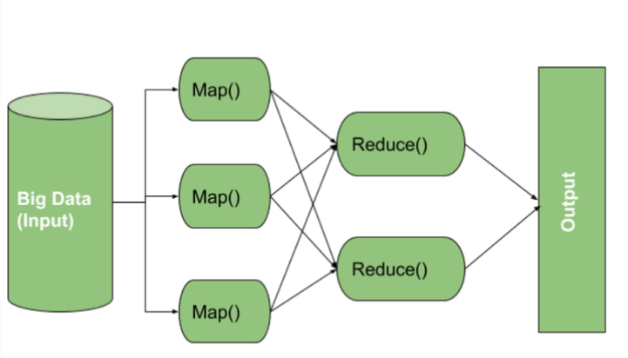
How to Handle Big Data? Processing
MapReduce is a programming model and an associated implementation for processing and generating big data sets with a parallel, distributed algorithm on a cluster.
Each one of the Map() and Reduce() functions can run on different computer (worker nodes).
There is a “master” node controlling the process.

Slide 10
How to Handle Big Data? Processing
Map: each worker node applies the map function to the local data, and writes the output to a temporary storage. A master node ensures that only one copy of the redundant input data is processed.
Shuffle: worker nodes redistribute data based on the output keys (produced by the map function), such that all data belonging to one key is located on the same worker node.
Reduce: worker nodes now process each group of output data, per key, in parallel.
Example: The input is millions of text files.
Mapping means creating word frequency data about each of the files.
Reducing: putting the word frequency data together.
-> We have a search index, like Google’s, created in parallel.

Slide 11
Next..
Lab sheet: Training for the final exam.
Please take a look at the Exam Instructions in Class materials.

